Slide 1
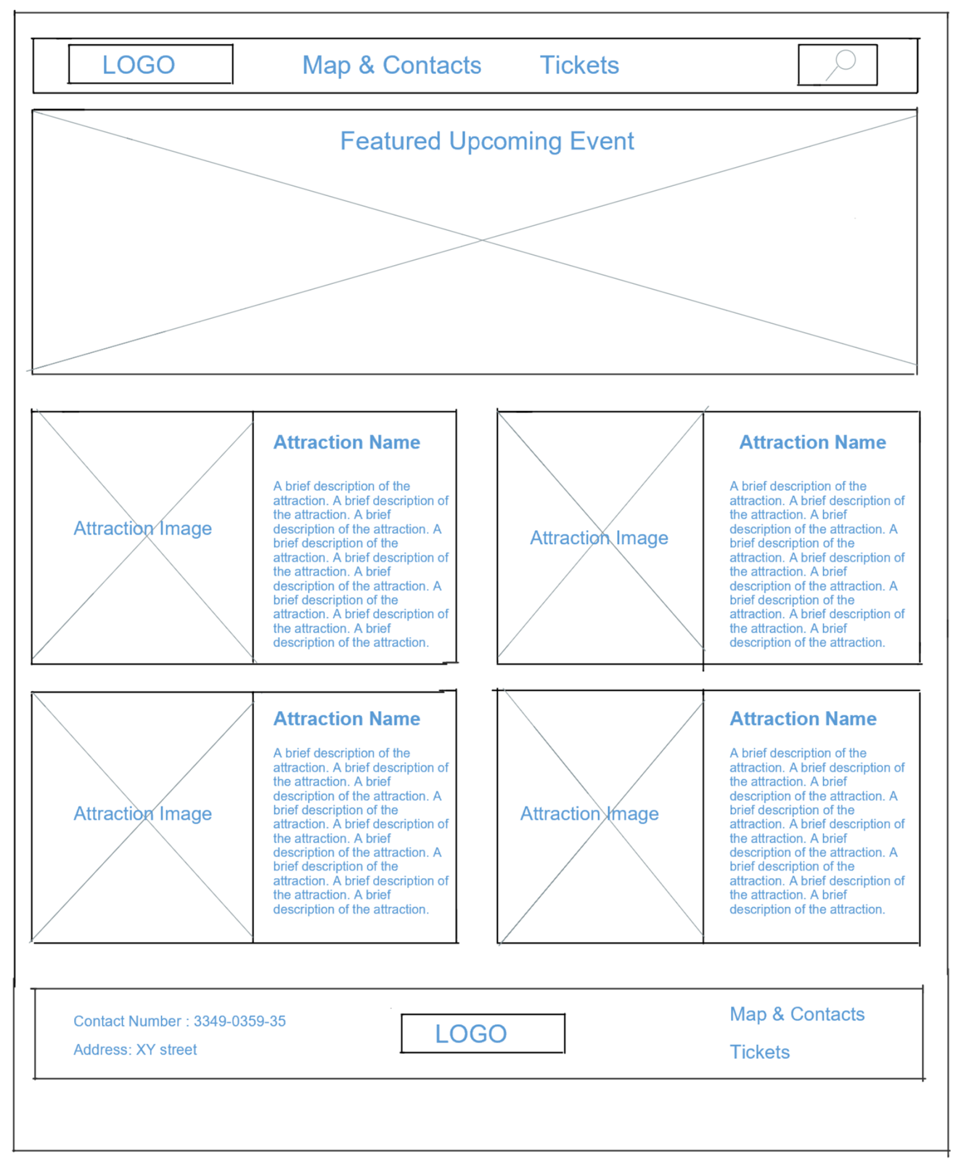
<header> (Molot font, blue)
<img>
<nav> (Arimo font, green/blue hover)
<div class=”featured”>
Body with black background
(Molot font, red)
(Molot font, red)
<div class=“attraction”>
<div class=“attraction”>
(Arimo font, blue)
(Arimo font, blue)
(Molot font, red)
(Molot font, red)
<div class=“attraction”>
<div class=“attraction”>
(Arimo font, blue)
(Arimo font, blue)
<footer>
(Arimo font, white)
<img>
<a>
<address>
<a>

Slide 2
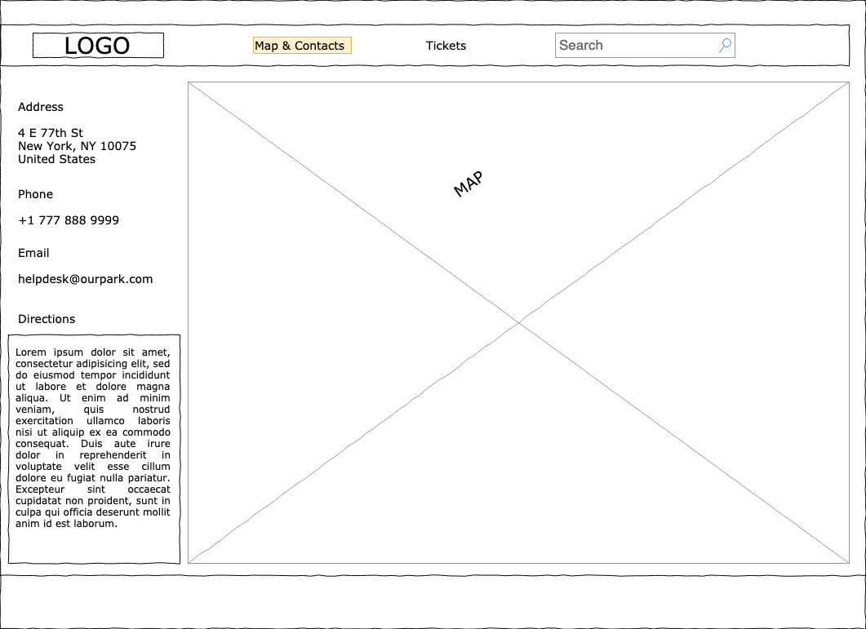
<header> (Molot font, blue)
<img>
<nav> (Arimo font, green/blue hover)
<div class = “contactinfo”>
Body with black background
<address>
(Arimo font, white)
<h3>
(Molot font, red)
<p>
<iframe>
(Arimo font, blue)
<footer>
(Arimo font, white)

Slide 3
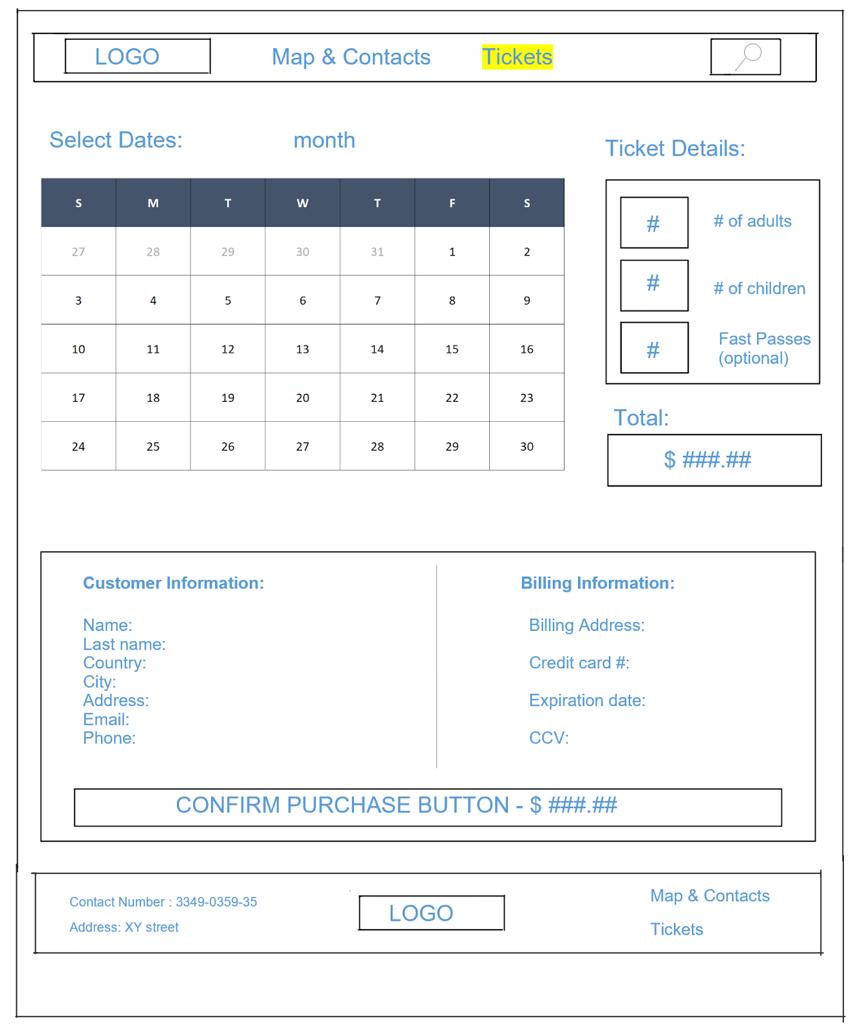
<header> (Molot font, blue)
<img>
<nav> (Arimo font, green/blue hover)
<form>
<input>
<label>
<input>
<fieldset>
<legend>
(form has Arimo font, black)
<input>
<label>
<input>
<label>
<button>
</form>
<footer>
(Arimo font, white)
<img>
<a>
<address>
<a>

